Slide 1

Devs. Unite

Slide 2

Elevator Pitch

Slide 3
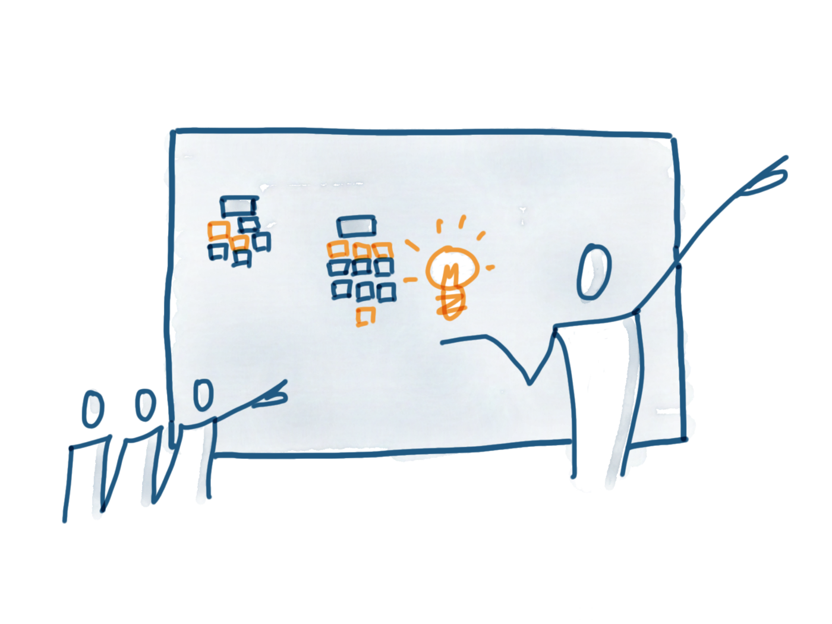
Concept
Description
Motivation for development?
User story

Slide 4

Process
Technologies used
Breakdown of tasks and roles
Challenges
Successes

Slide 5

Demo

Slide 6

Directions for Future Development

Slide 7

Links
Deployed - https://powerful-stream-91686.herokuapp.com/
GitHub repo - https://github.com/J-Howell-kc/Developer-Meeting-Tool

